Slide 1
Lesson 1 - Water’s Many Forms
Farming & Our Food - A Grade 2 Water Cycle Unit
This lesson was created by Grain Farmers of Ontario to be used by Ontario educators in the classrooms. For any questions or concerns regarding use please contact bcurtis@gfo.ca

Slide 2
These lessons are designed to empower you in leading engaging, hands-on STEAM activities that directly connect with the Ontario Science curriculum. We understand that every classroom is unique, so each lesson offers a variety of options for implementation. Choose the approach that best suits your students and learning environment.
Notes:
Educator Notes:
This is the first lesson in a unit designed to teach Grade 2 students about the water cycle.
The unit emphasizes the vital connection between water, farming, and our food supply in Ontario.

Slide 3
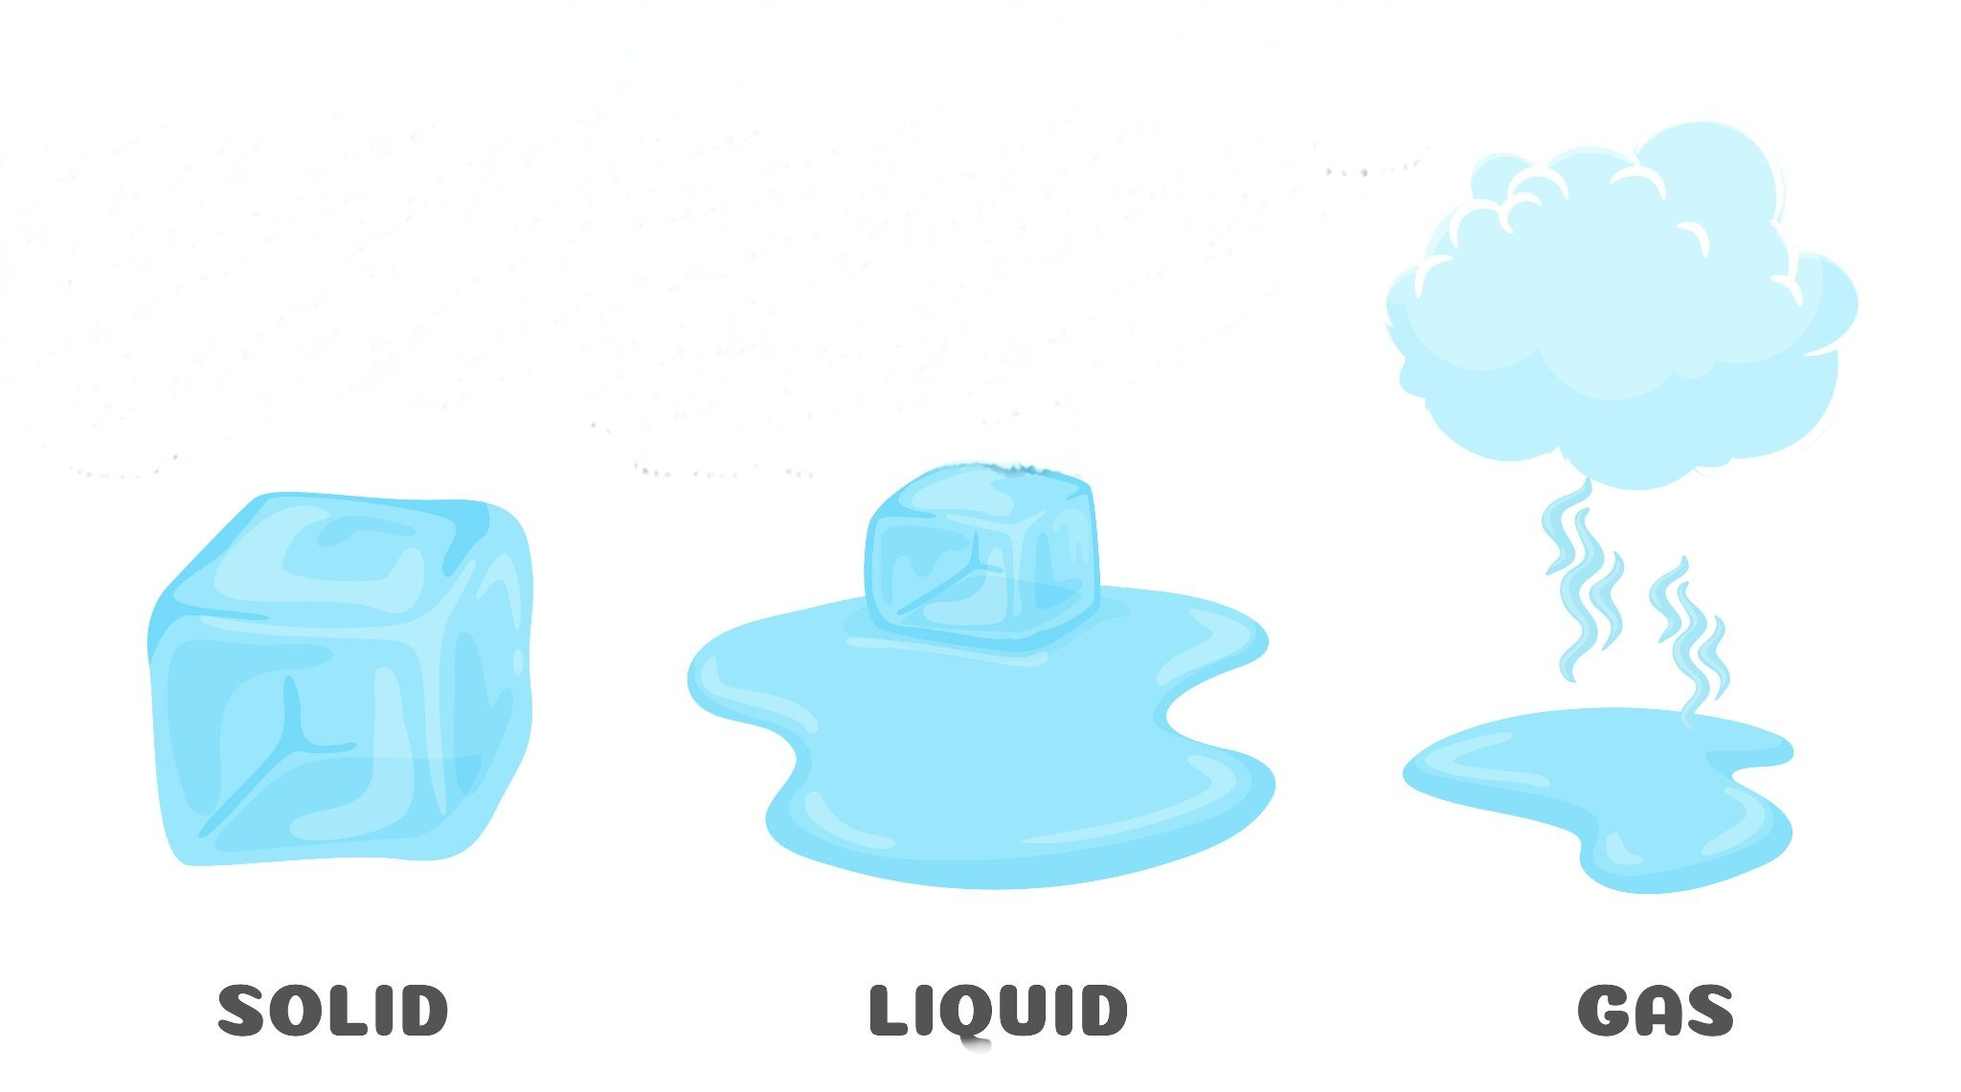
Lesson Overview
What We'll Explore: Water's Changing States
Learning Goal:
Students will be able to identify water in its three states (solid, liquid, gas) and understand that temperature changes its state.
Curriculum Connections:
Overall: E2. demonstrate an understanding of the properties of air and water, including water in various states, and of ways in which living things depend on air and water for their survival.
Overall: C2. demonstrate an understanding of the properties and physical changes of liquids and solids.
Specific: E2.4 identify the three states of water in the environment, and describe how temperature changes affect the state of water within the water cycle.
Specific: C2.3 describe properties of liquid water and solid water, and identify the conditions that cause changes from one state to the other.
Key Concepts:
Solid, Liquid, Gas
Temperature changes water's state
Water is essential for farming
Notes:
Educator Notes:
Clearly state the learning objective for students.
The above are the specific curriculum expectations covered in this lesson; more are covered in the following lessons.
This lesson lays the foundation for understanding the water cycle by focusing on water's different forms.
A friendly reminder that the farming connection will be woven throughout the activities.

Slide 4
Materials & Activity
Getting Ready: Materials & Your Choices
General Materials Needed:
Chart paper or Whiteboard, markers
Slide show
Possible items: ice cube, cup of water
Option 1: Common Materials - Observing Water States on a farm
Focus: Hands-on observation of melting and evaporation using simple, readily available items.
Additional Materials: Dark-coloured, non-absorbent surfaces (e.g., dark ceramic tiles, small dark plastic lids, small pieces of dark laminated paper, or sections of a chalkboard/Whiteboard for individual use).
Ice cubes (enough for each student or small group)
Small bowls or plates (one per student/group)
Kettle or hot plate (for adult use only, to create steam – teacher demonstration only for steam)
Option 2: Slightly More Complex - DIY Water Cycle
Focus: Building a contained model to observe all three states and the start of the water cycle.
Additional Materials: Clear plastic bottles or plastic containers (one per small group)
small plant or soil. Possibly use plastic wrap with rubber band.
Notes:
Educator Notes:
Teachers choose the option that best suits your classroom resources and student needs.
Steam demonstration is strictly for an adult to perform, for safety.
For Option 1, dark surfaces are crucial for clearly seeing the "disappearing" water.
For Option 2, the mini-greenhouse will show the start of the water cycle (evaporation, condensation, and tiny "rain" droplets).

Slide 5
Minds On
Notes:
(10-15 minutes)
Educator Notes:
Purpose: To activate prior knowledge about water and introduce the concepts of solid and liquid states.
Tips: Encourage a wide range of answers for "Where do we see water?" to broaden their understanding. Guide the discussion toward the observable differences between ice and liquid water.
Farming Link: This initial connection helps set the context for the entire unit, grounding the science in a real-world application relevant to Ontario.
You can display the pictures provided in the slides or have your own materials ready to go for students to explore.

Slide 6

Notes:
Educator Notes:
Engage with Water: Show students a glass of water, or display the above picture. Ask: "What is this? Where do we see water every day?" (e.g., drinking, washing hands, rain, snow).

Slide 7
Notes:
Educator Notes:
Introduce States: Place an ice cube in a clear container. Or display the above picture. Ask: "What is this? Is it water? How is it different from the water in the glass?" Introduce "solid" and "liquid."

Slide 8
Think – Pair - Share
What happens to ice when it gets warm?

Slide 9
Notes:
Educator notes:
Introduce the fact that states can change from a solid to a liquid.

Slide 10
Notes:
Educator notes:
Introduce the fact that states can change from a solid to a liquid.

Slide 11
Do farmers need water?
What do they use it for?
Notes:
Educator notes:
Ask: "Do farmers need water? What do they use it for?" (drinking for animals, growing plants). Emphasize that water is essential for all living things on a farm.

Slide 12
Action

Slide 13
Option 1:
Observing Water States on a Farm
Notes:
20-24 minutes
Educator Notes:
Scaffolding: Encourage students to use descriptive words when observing the ice and water. Prompt them with questions like "What do you notice happening?" or "How is this like what happens on a farm?"
Safety: Reiterate strict safety for the steam demonstration. Ensure students are at a safe distance and understand not to touch hot surfaces.
Farming Connection: Continuously reinforce the farming context: "Farmers see solid water (snow) melt into liquid water for their fields, and liquid puddles evaporate into invisible gas on sunny days." The sorting activity helps solidify these connections visually.

Slide 14
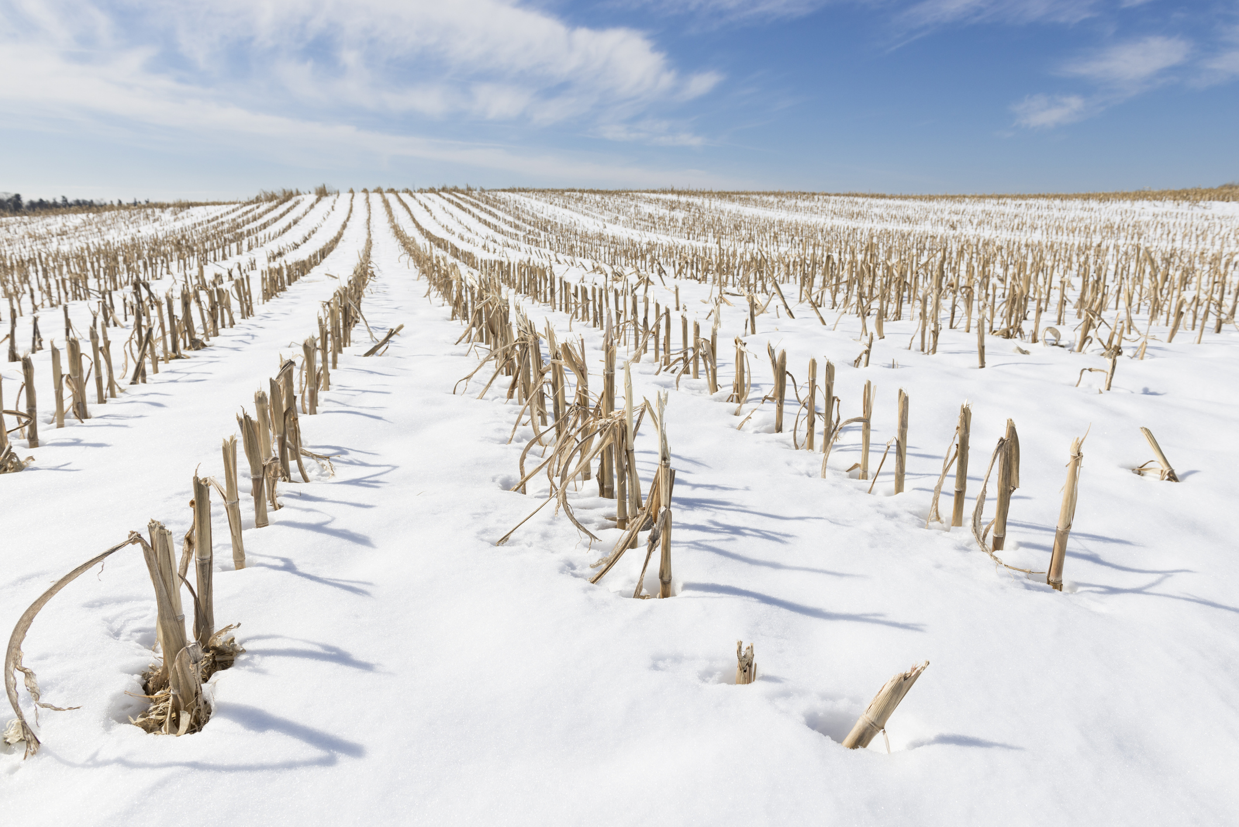
Snow on a Farm
Field in Spring
How does it feel?
How does it look?
How is the ice cube changing?
How do you think melting snow provides water for farm soil?
Notes:
Hands-On "Spring Melt" Simulation: Give each student or small group an ice cube on a small bowl or plate. Frame it as "snow on a farm field in spring." Have them touch it (if comfortable), observe it closely, and describe how it feels and looks. Watch together as it starts to melt. Discuss the change from solid to liquid, connecting it to how melting snow provides water for farm soil.

Slide 15
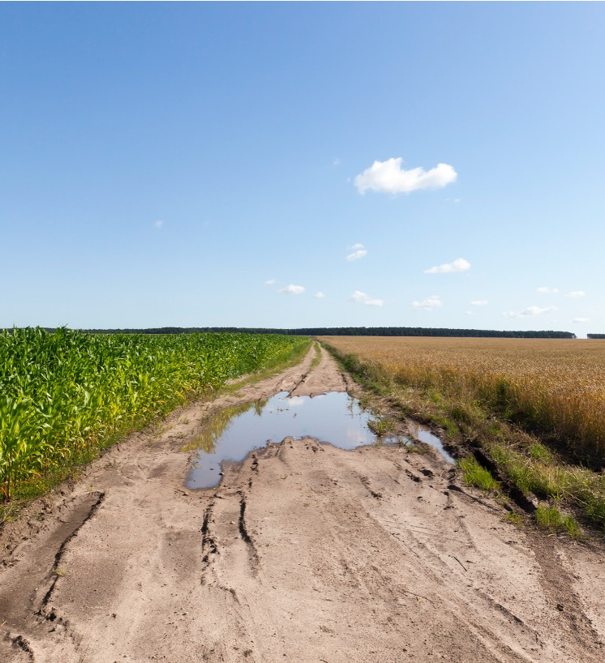
Puddle on
a grain farm
What’s happening to the puddle on the farm?
How does the puddle disappear?
Notes:
Individual "Puddle Disappearance" Observation: Provide each student or small group with a dark-coloured, non-absorbent surface. Have them use a dropper or their finger to place a small drop of liquid water on the surface, imagining it's a "puddle on a grain farm." Observe what happens to their own water drop over time. Discuss how it seems to "disappear" – it's actually turning into invisible water vapour that is evaporating, just like puddles on a sunny field. This happens in the spring on the farm or after a very rainy day.

Slide 16
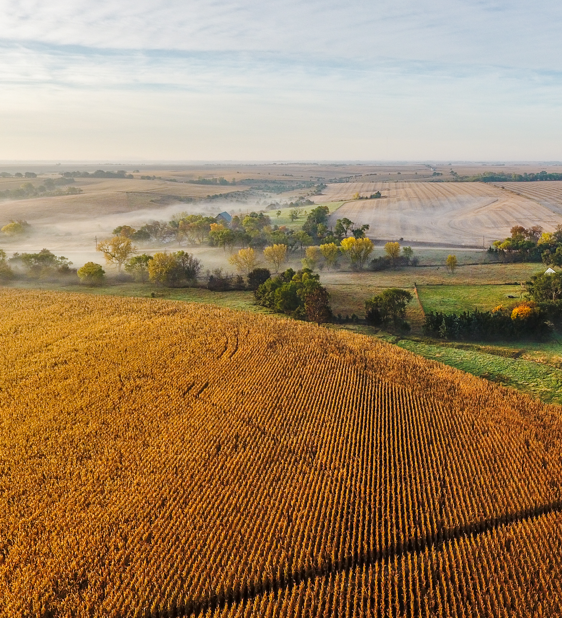
A Foggy Farm
Where did the water go?
What do you think happens to water on a farm when it gets warm, humid or there is changing temperatures during sunrise?
We learned that sometimes we can see water as steam or fog, but mostly it's an invisible gas in the air! Why do you think it's important for water to turn into this invisible gas and move around in the air?
Notes:
Introduce Gas (Steam): (Adult supervised) Carefully boil a small amount of water in a kettle. Point out the steam rising. Explain that this is water in its gas form, called water vapour. Emphasize it's invisible once it mixes with the air, but we can sometimes see it as steam or fog. Discuss how warm, wet areas on a farm (like the fluctuating temperatures on a field during sunrise) might have water evaporating into the air.

Slide 17
Option 2:
Making Our Own Farm Water Cycle

Slide 18
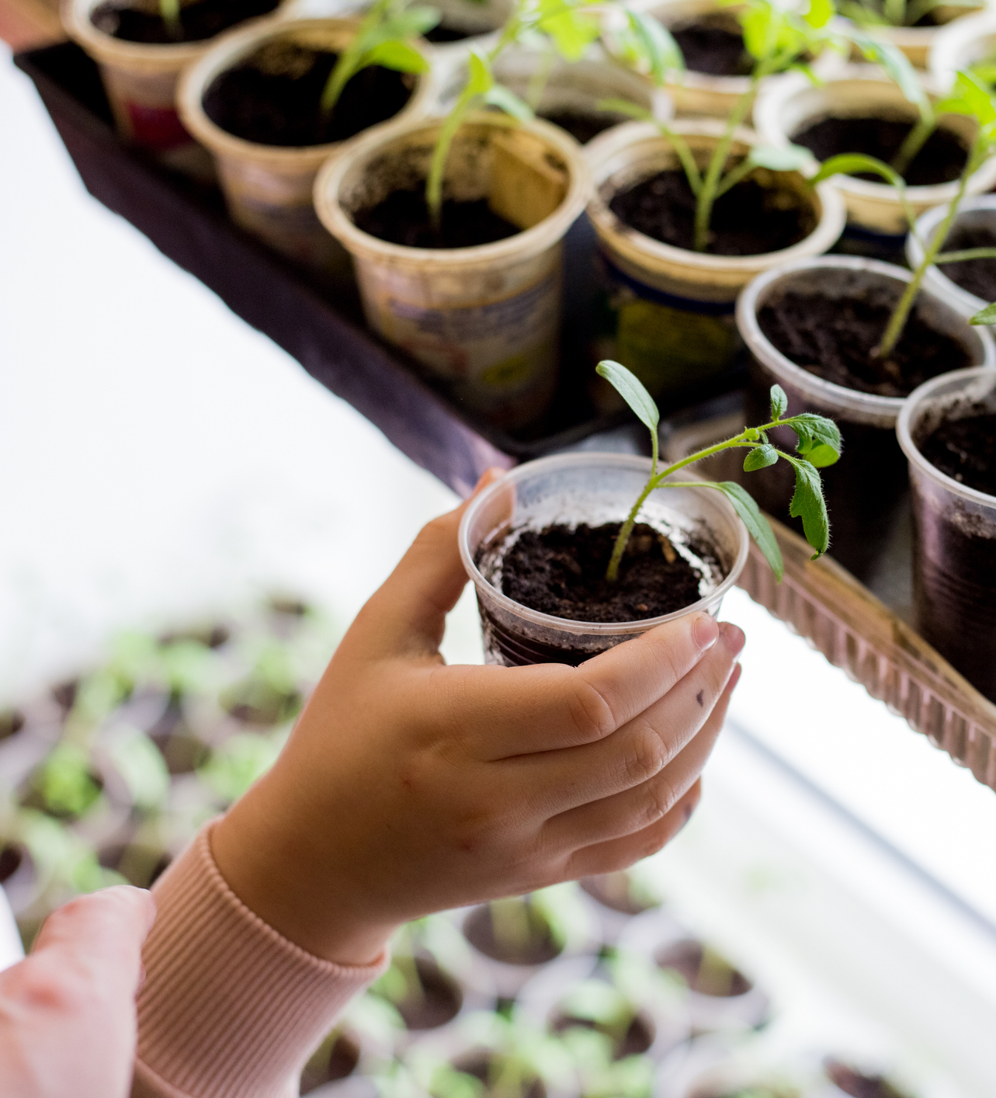
Let’s Build Our
Farm Water Cycle
You will need:
Plastic bottle (cut in half horizontally, place a plant inside, then attach the top half to create a dome, or use a clear plastic container with a lid)
A small plant
Some damp soil
You might also use plastic wrap and a rubber band to create a lid
Notes:
Educator Notes:
While, grain farms don’t grow grains in greenhouses, creating a DIY Farm Water Cycle using the science behind greenhouses is a great way to introduce the water cycle to students!
Students Build DIY Water Cycles: Divide students into small groups or have each student make their own. Provide each group with a clear plastic bottle (cut in half, then attach the top half to create a dome, or use a clear plastic container with a lid), a small plant, some damp soil, you might also use plastic wrap, and a rubber band to create a lid. Guide them through building their own DIY water cycle

Slide 19
Let’s Observe Our Farm Greenhouse
Let’s place our mini-greenhouse in a sunny spot.
Look for:
Missing Water: Watch closely to see if some of the water from the soil and plant seems to disappear. It's turning into an invisible gas!
Tiny Drops on the Plastic: Look for little water drops forming on the inside of the plastic bag or container. This is like clouds forming!
"Rain" Falling Down: See if any of those tiny drops get bigger and slide or "rain" back down toward the soil.
Notes:
Educator Notes:
Students will observe:
Water evaporating from the soil/plant (invisible gas).
Condensation forming on the inside of the plastic (liquid droplets).
Small "rain" droplets falling back down (simulated precipitation/collection).
Record Observations: Have students draw or write about what they observe happening inside their group's farm water cycle, labeling the states of water they see.

Slide 20
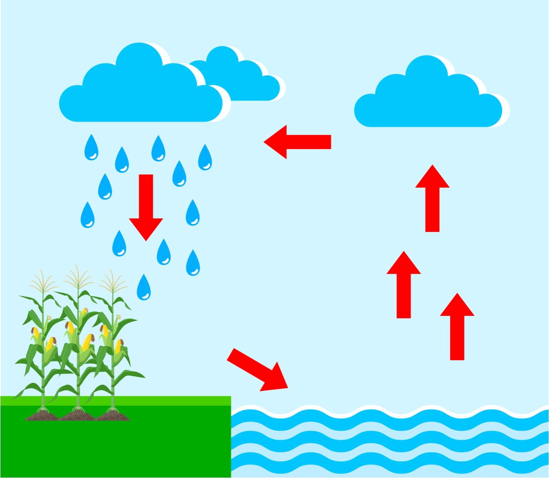
Connect
to Farming
Grain farmers rely on the sun to evaporate water from their fields, forming clouds that bring rain back to their grain plants. This constant movement of water helps their grains grow big and strong!
Notes:
Educator tip:
Discuss how these represent a small version of the water cycle. Some farms that grow vegetables use green houses to provide constant water for their growing plants. Other farms like grain farms rely on the sun to evaporate water from their fields, forming clouds that bring rain back to their grain plants. This constant movement of water helps their grains grow big and strong! Emphasize that grain farmers depend on the natural water cycle for their grain plants.

Slide 21
Consolidation

Slide 22
Can you think of a
SOLID, LIQUID, AND GAS
found on a farm environment?

Slide 23
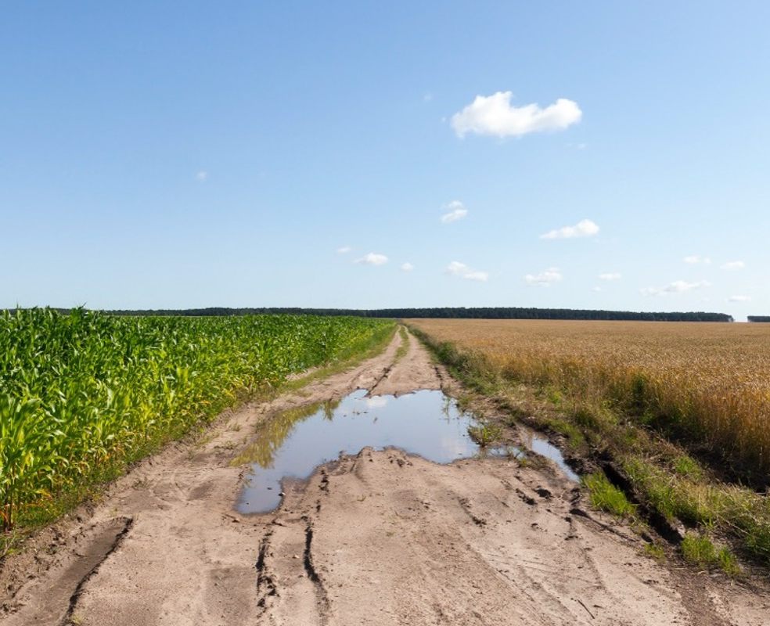
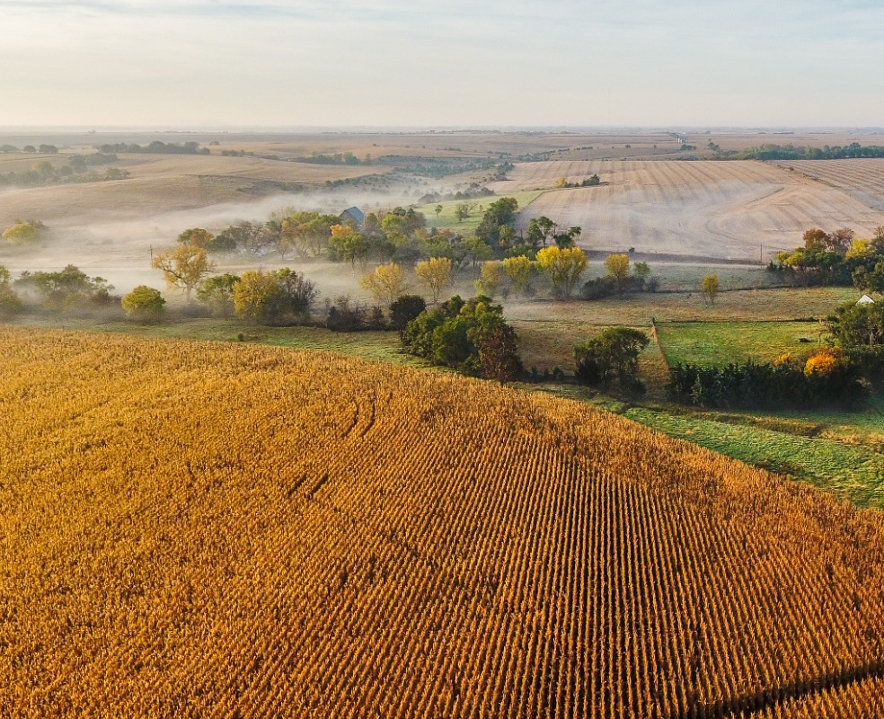
Do you remember?
SOLID
LIQUID
GAS
Here water is in
a solid state - snow
Here water is in a liquid
state - this happens from
melting snow or rain fall.
Here water is in a gas
state - this happens when heat makes the water evaporate.

Slide 24
How does heat (the sun)
make ice melt and liquid
water turn into gas?
What makes water turn
back into ice?
Notes:
Educator notes;
You could use the consolidation questions as a formative assessment or use the provided Lesson 1 exit ticket. Exit tickets can be downloaded from https://goodineverygrain.ca/2026/01/06/water-on-farms-a-six-lesson-unit-for-grade-2/ .

Slide 25
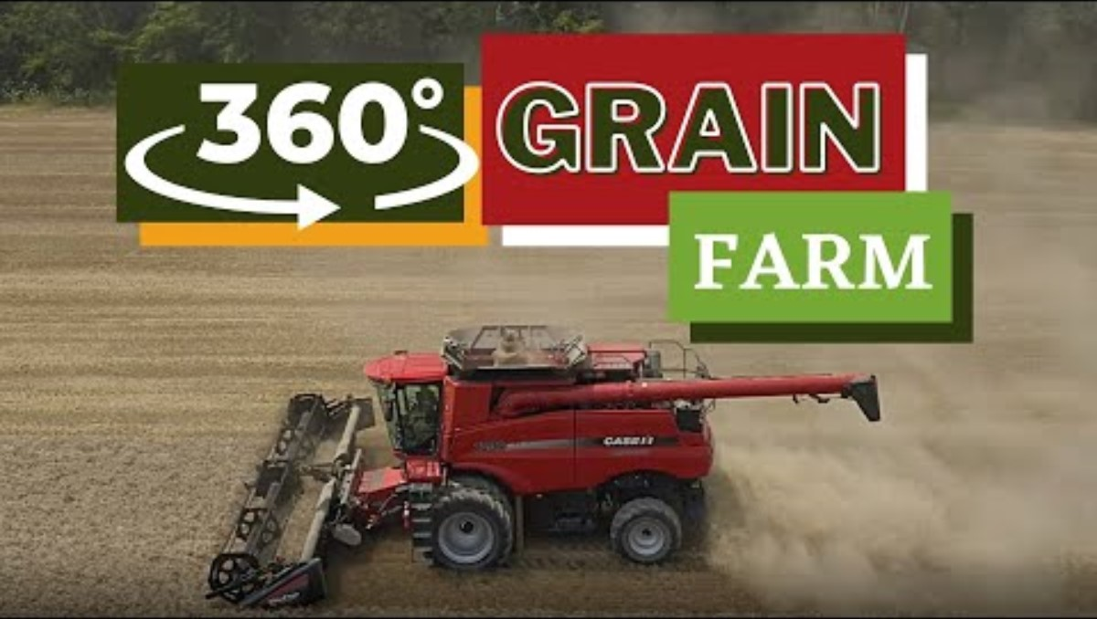
Want More?
Check out these sources and resources to further dive into water and farm
Follow a grain farmer in Ontario planting soybeans throughout the seasons.
Notes:
360 Grain Farm video taken from: https://www.farmfood360.ca/en/ontario-grain-farms/
Use the provided Lesson 1 exit ticket (https://goodineverygrain.ca/2026/01/06/water-on-farms-a-six-lesson-unit-for-grade-2/ ) or have students record their answers in their notebooks, on a sticky note, or on a piece of paper.

